Slide 1
Moving from Rome to Toronto
Using Machine Learning to recommend neighbourhoods for relocation

Slide 2
Rome and Toronto
Since both are quite large and important cities, neighborhoods within those cities are quite different from each other.
As an example, a person from Centocelle (Rome) would adjust better in Harbourfront East (Toronto) than in Summerhill East (Toronto), where he/she can enjoy a similar density of restaurants and cinemas; while Summerhill may be better for someone from Trastevere (Rome), where he/she can appreciate the green area.
The purpose of this project is to use Foursquare location data to identify the types of venues within each neighborhood and calculate the "similarity" a Roman neighborhood will have to a Toronto neighborhood.
At then end of the project, the person from Rome who needs to relocate will type his/her neighborhood and he/she will be provide with a ranking of the “less distant” Toronto neighborhoods from his/her own.

Slide 3
Data acquisition and cleaning
Canada postcode available at https://en.wikipedia.org/wiki/List_of_postal_codes_of_Canada:_M
Canadian postcode latitude and longitude available at http://cocl.us/Geospatial_data
Italian postcode latitude and longitude available at http://download.geonames.org/export/zip/
Roman neighborhoods available at http://www.roma-o-matic.com/zoom.php3?actions[Z]=x
Data have been grouped together to obtain one row per neighbourhood with latitude and longitude, for a total of 123 observations
Foursquare location data

Slide 4
The Kmeans algorithm
The goal is to obtain a square matrix of euclidean distance across neighbourhoods.
This can be obtained easily by using an initial number of clusters (K) equals to the number of neighbourhoods.
During the execution, it became evident that few roman neighborhoods are so similar to each other that the algorithm can not separate them into different cluster (same distance with any other cluster).
An example of the above consists of "Torre Angela" and "Borghesiana", two neighborhoods next to each other in Rome that can be reasonably grouped into a single neighbourhood.
Procedure for the choice of number of Cluster (K)
1. K=123 (number of neighbourhoods) has been chosen as a starting K
2. If the Kmeans algorithm is not able to converge because of the existence of too similar neighbourhood, the k is decrease by 1
3. The loops stops when the algorithm is able to converge.
Starting from 123, the final k has converged into 107 clusters and few Roman neighbourhoods have been grouped together

Slide 5
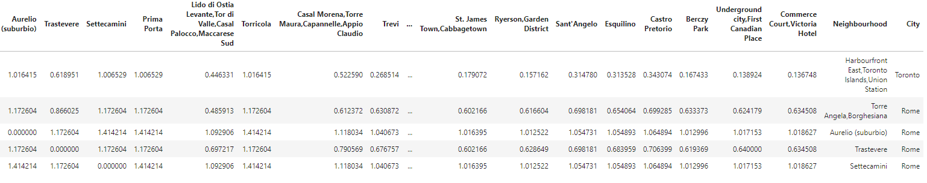
Recommendation matrix with euclidean distances

Slide 6
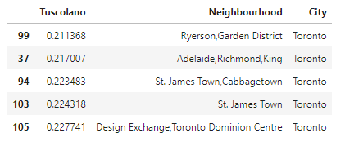
Results
Taking Tuscolano as an example
Additional statistics:
Most similar couple of roman/Toronto neighbourhoods: Monti and Design Exchange,Toronto Dominion Centre with a distance of 0.20815036178207
Most dissimilar couple of roman/Toronto neighbourhoods: Aurelio (suburbio) and Roselawn with a distance of 1.4142135623731
The distance average between Toronto and Rome is 0.542667019235158
The closest place to Tuscolano would be Ryerson,Garden District.

Slide 7
Conclusion
By using Foursquare location data, Rome and Toronto geo data, the kmeans cluster algorithm and the euclidean distance, it has been possible to create a recommendation matrix to help relocate people from Rome to Toronto (or the other way around) based on the neighbourhood of origin.
This kind of data is really easy to obtain, meaning that this analysis can be replicated for any city

